Slide 1
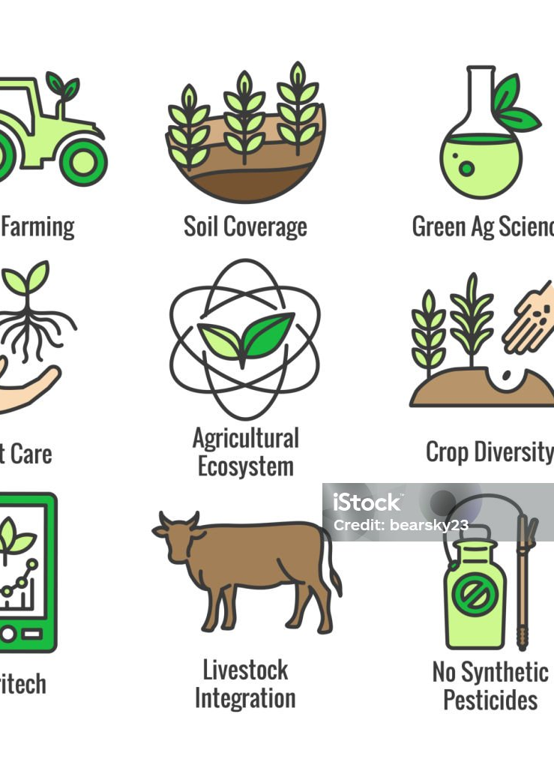
What is Agroecology?
Agroecology integrates ecological and social principles into food systems. The 13 principles include
Recycling – Reuse local inputs across borders
Input Reduction – Minimizes dependency on external inputs
Soil Health –Trade promotes local soil regeneration
Animal Health – Ensures humane handling in trade
Biodiversity – Promotes diverse products for trade
Synergy – Connects producers, traders, ecosystems harmoniously
Economic Diversification – Expands trade opportunities for farmers
Co-creation of Knowledge – Sharing farmer practices, experiences across regions
Social Values and Diets – Supports culturally appropriate food exchanges
Fairness – Ensures equity in trade systems
Connectivity – Strengthens producer-market trade links
Land and Resource Governance – Secures access to resources for sustainable trade
Participation – Engages communities in trade decisions
Notes:
Sovereignty in food systems and translates into sovereignty in trade, just trade,

